Slide 1
Thermohaline Mixing in Low-Mass Stars on the Red Giant Branch
Pavel Denisenkov, UVic

Slide 2
Contents
1. Animated introduction to the mixing events in low-mass stars on the red giant branch (RGB): convective first dredge-up and extra mixing above the bump luminosity
Thermohaline convection as a mechanism for the RGB extra mixing: linear-theory approximation and its uncertainties
Testing the hypothesis of RGB thermohaline mixing with 2D and 3D numerical simulations
Are there any prospects for a solution?

Slide 3
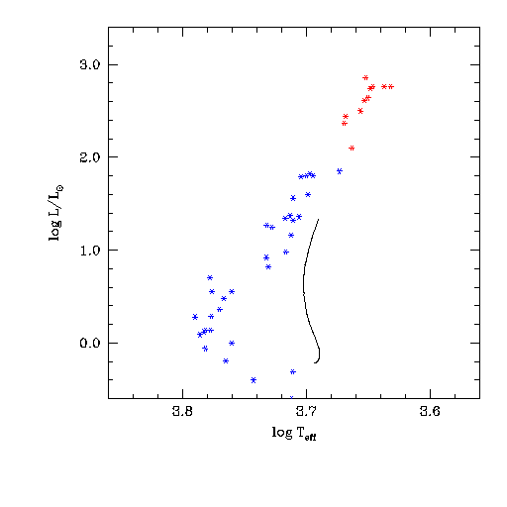
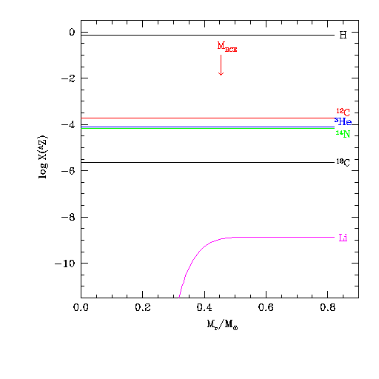
Left: Evolution of a low-mass star in the HR diagram (M = 0.83M , Z = 0.0015) Right: Changes of abundance profiles inside the star that drive its evolution
Data points are field stars with M = 0.8 – 0.9M, Z = 0.0005 – 0.002 from Gratton et al. (2000)
Arrow in the right panel shows the bottom of convective envelope

Slide 4
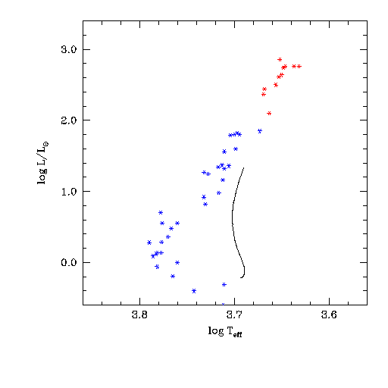
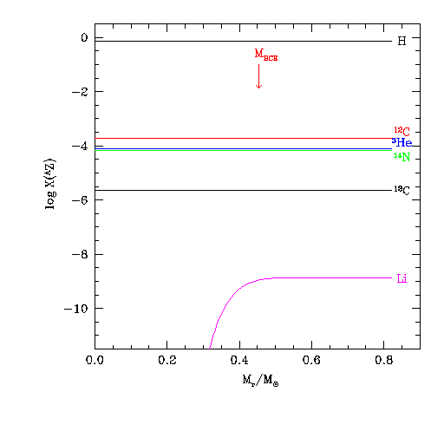
Left: Evolution of a low-mass star in the HR diagram (M = 0.83M , Z = 0.0015) Right: Changes of abundance profiles inside the star that drive its evolution
when the star approaches the MS, Li is destroyed everywhere except in a thin envelope
on the MS, ³He is produced in a wide pocket
after the MS, convection dilutes Li and spreads ³He all over the envelope (the 1st dredge-up)
a hump in the ¹³C profile is engulfed by convection as well, which reduces the ¹²C/¹³C ratio

Slide 5
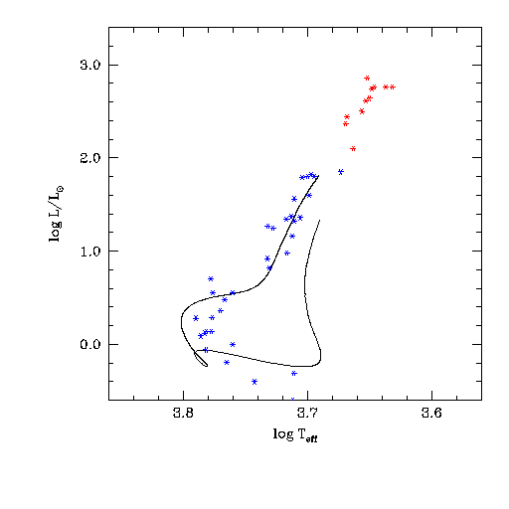
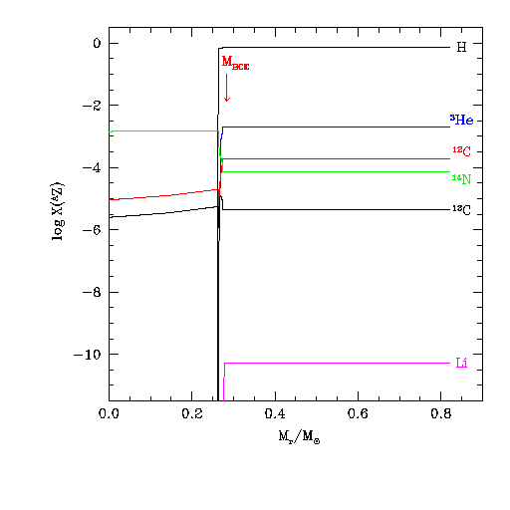
Left: Evolution of a low-mass star in the HR diagram (M = 0.83M , Z = 0.0015) Right: Changes of abundance profiles inside the star that drive its evolution
when the star approaches the MS, Li is destroyed everywhere except in a thin envelope
on the MS, ³He is produced in a wide pocket
after the MS, convection dilutes Li and spreads ³He all over the envelope (the 1st dredge-up)
a hump in the ¹³C profile is engulfed by convection as well, which reduces the ¹²C/¹³C ratio

Slide 6
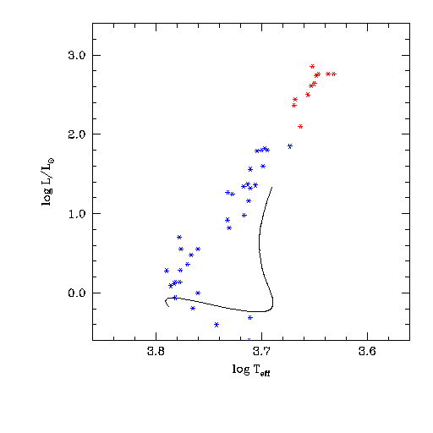
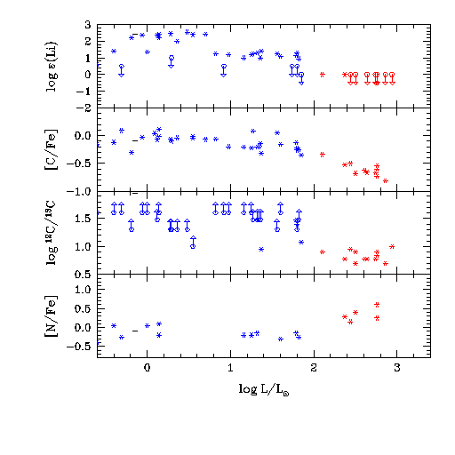
Left: Evolution of a low-mass star in the HR diagram (M = 0.83M , Z = 0.0015) Right: Changes of the surface abundances produced by the first dredge-up

Slide 7
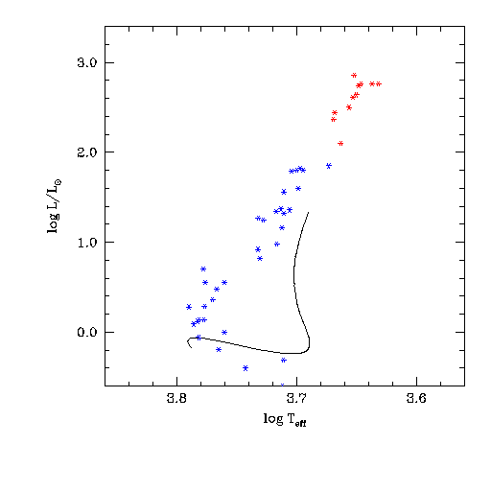
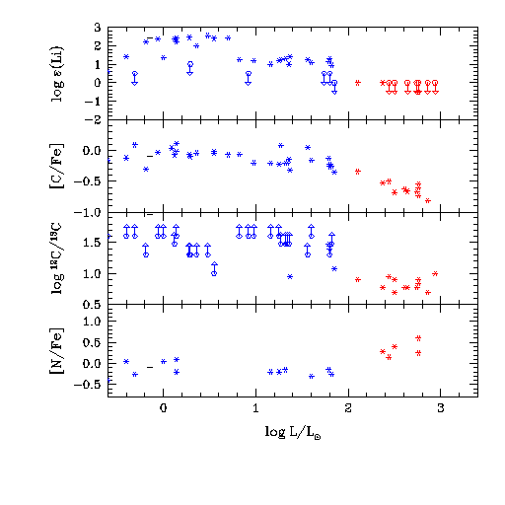
Left: Evolution of a low-mass star in the HR diagram (M = 0.83M , Z = 0.0015) Right: Changes of the surface abundances produced by the first dredge-up
The First Dredge-Up: after the MS, convection
dilutes Li
increases the surface ³He abundance (not seen)
reduces the ¹²C/¹³C ratio

Slide 8
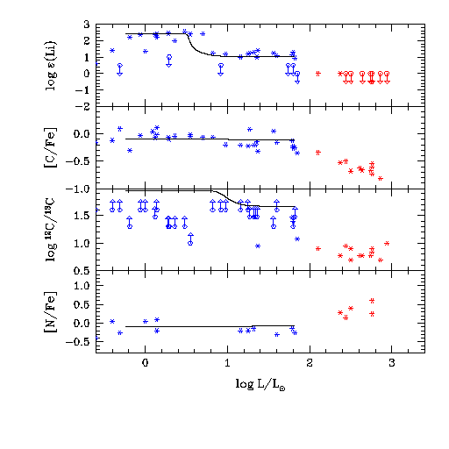
Left: Evolution of a low-mass star in the HR diagram (M = 0.83M , Z = 0.0015) Right: Changes of the surface abundances produced by the first dredge-up
The First Dredge-Up: after the MS, convection
dilutes Li
increases the surface ³He abundance (not seen)
reduces the ¹²C/¹³C ratio

Slide 9
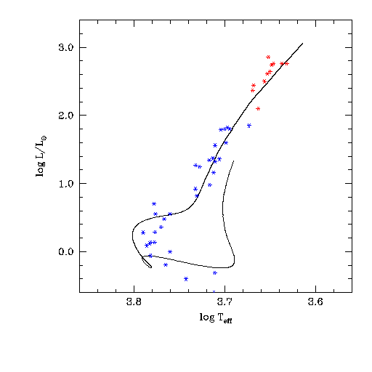
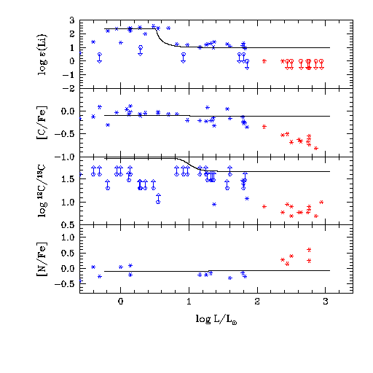
Left: Evolution of a low-mass star in the HR diagram (M = 0.83M , Z = 0.0015) Right: Changes of the surface abundances resume above the bump luminosity
We need some extra mixing to explain the RGB abundance patterns above the bump luminosity

Slide 10
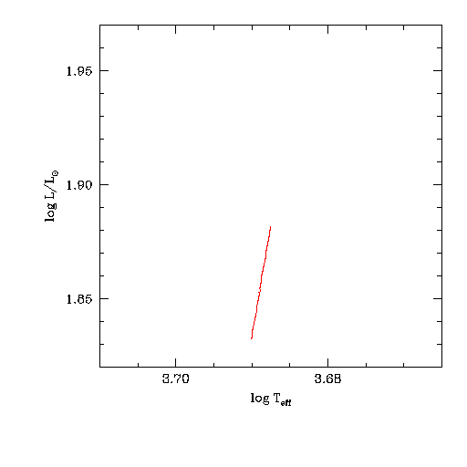
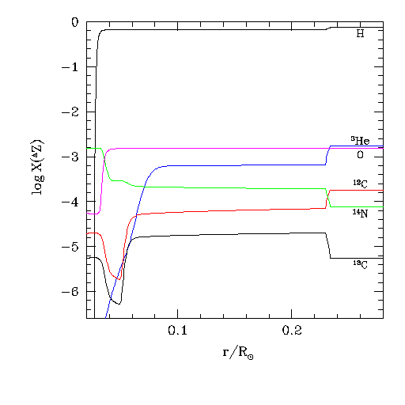
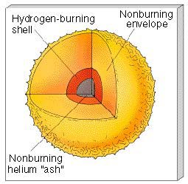
Left: Evolution in the HRD around the bump luminosity (M = 0.83M , Z = 0.0015) Right: H-burning shell erases abundance discontinuities
What happens at the bump luminosity?

Slide 11
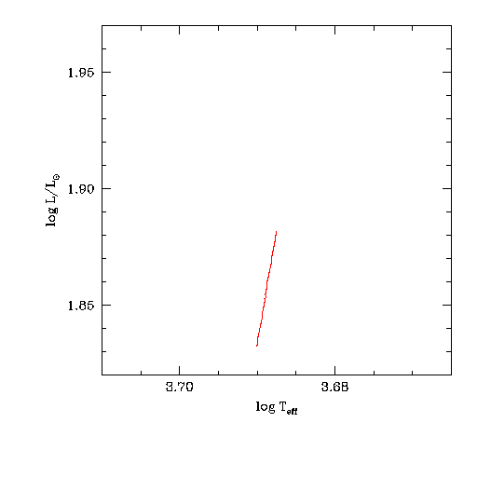
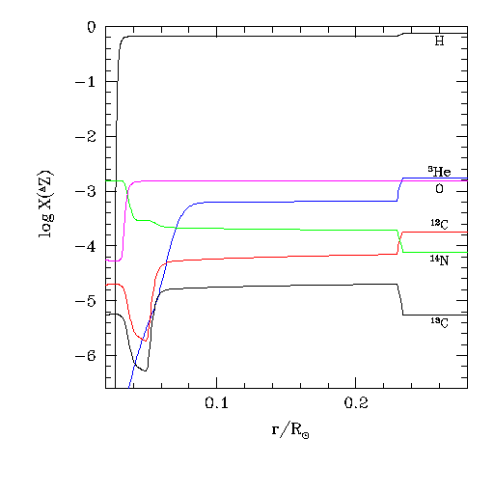
Left: Evolution in the HRD around the bump luminosity (M = 0.83M , Z = 0.0015) Right: H-burning shell erases abundance discontinuities
What happens at the bump luminosity?

Slide 12
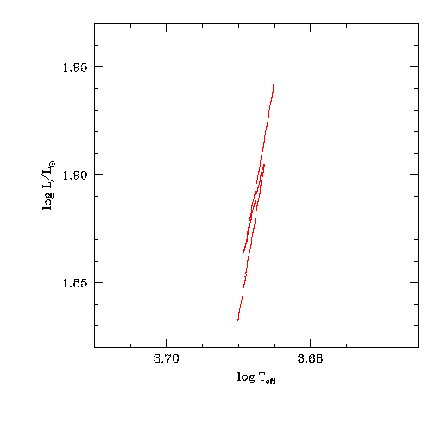
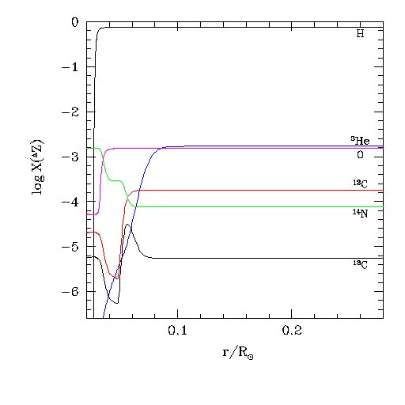
Left: Evolution in the HRD around the bump luminosity (M = 0.83M , Z = 0.0015) Right: H-burning shell erases abundance discontinuities
What happens at the bump luminosity?
On upper RGB, above the bump luminosity, the radiative zone has uniform chemical composition, which facilitates fluid buoyancy of any origin

Slide 13

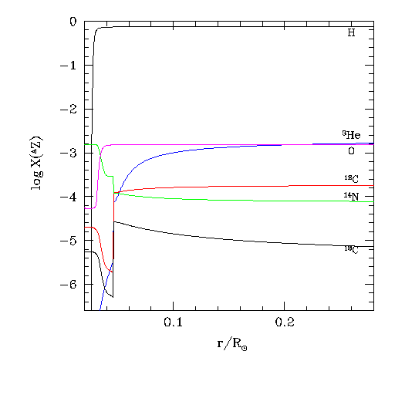
Right: Diffusion coefficient D_{mix} = (0.02 - 0.1) × K, or D_{mix} = 4 × 10⁸ cm² s⁻¹, with a mixing depth r_{mix} = 0.04 – 0.06 R reproduce the observed abundance patterns on the Left
A semi-empirical model of extra mixing in a low-mass RGB star

Slide 14
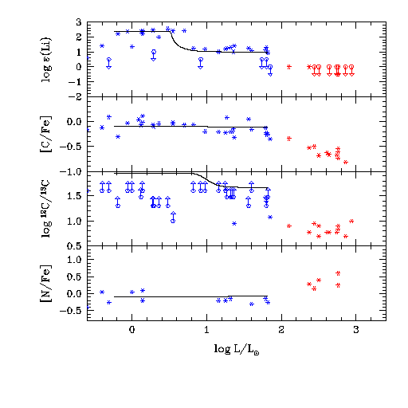
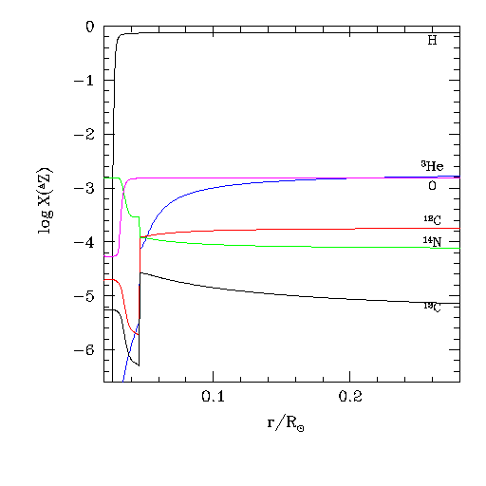
Right: Diffusion coefficient D_{mix} = (0.02 - 0.1) × K, or D_{mix} = 4 × 10⁸ cm² s⁻¹, with a mixing depth r_{mix} = 0.04 – 0.06 R reproduce the observed abundance patterns on the Left
A semi-empirical model of extra mixing in a low-mass RGB star

Slide 15
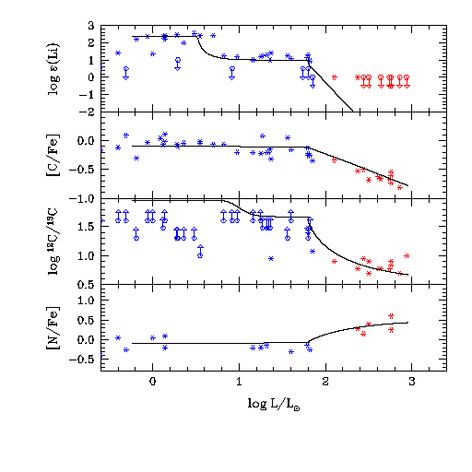
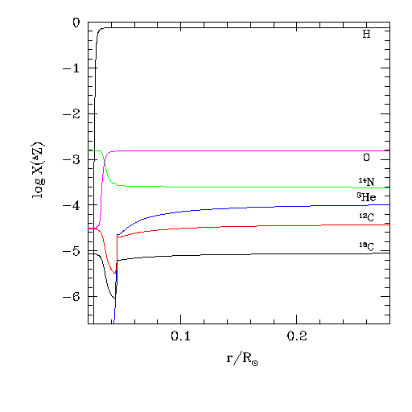
Right: Diffusion coefficient D_{mix} = (0.02 - 0.1) × K, or D_{mix} = 4 × 10⁸ cm² s⁻¹, with a mixing depth r_{mix} = 0.04 – 0.06 R reproduce the observed abundance patterns on the Left
A semi-empirical model of extra mixing in a low-mass RGB star
³He abundance is decreased by a factor of 16 (not seen on the left)

Slide 16
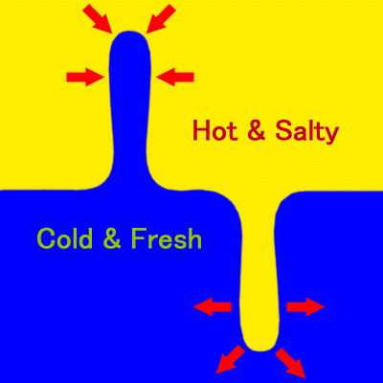
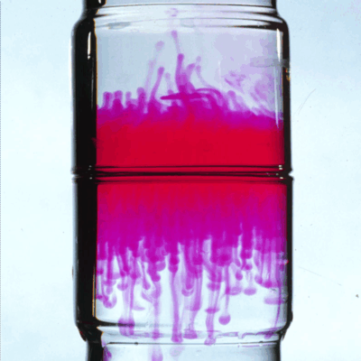
Thermohaline convection as a mechanism for extra mixing in RGB stars
Thermohaline convection is driven by a small difference in salinity S between a fluid element and its surrounding medium when the atomic diffusivity ν is much lower than the heat diffusivity K. In the ocean, it develops when both S and T decrease with depth and it takes a form of salt fingers, hence
“salt-fingering convection” is another term for it.
P ( µ*, ρ₁*,T )
Reaction ³He(³He,2p)⁴He decreases µ locally byΔµ ≈ −0.0001
Double-diffusive (νK) instability leads to growing salt fingers in water

Slide 17
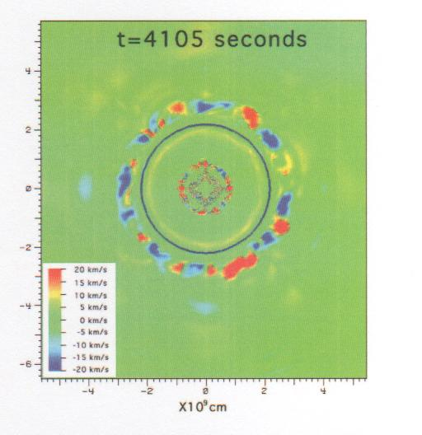
Thermohaline convection as a mechanism for extra mixing in RGB stars
From the Rayleigh-Taylor instability (Eggleton, Dearborn, & Lattanzio, 2006) to RGB thermohaline convection (Charbonnel & Zahn, 2007). In stellar cases, S is replaced by µ
Boussinesq equations
P*(µ*,ρ*,T*)
Linear-theory approximation
P ( µ*, ρ₁*,T )
The main uncertainty is the aspect ratio a
(Eggleton et al., 2006)
Reaction ³He(³He,2p)⁴He decreases µ locally byΔµ ≈ −0.0001

Slide 18
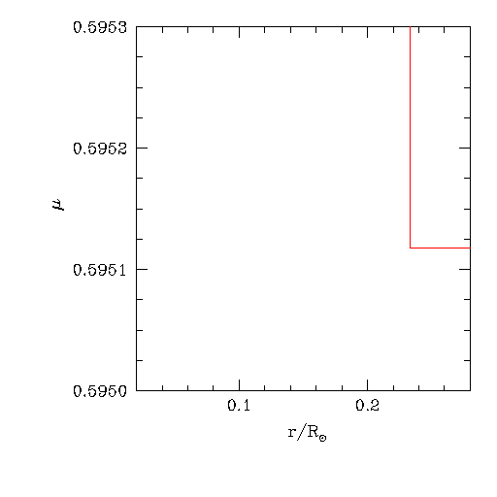
Thermohaline convection as a mechanism for extra mixing in RGB stars
The RGB thermohaline convection is driven by a small difference in µ between a fluid parcel and its surrounding medium because the atomic diffusivity ν is much lower than the heat diffusivity K. It develops when µ decreases with depth (usually, µ increases with depth in stars)
Reaction ³He(³He,2p)⁴He decreases µ locally byΔµ ≈ −0.0001

Slide 19
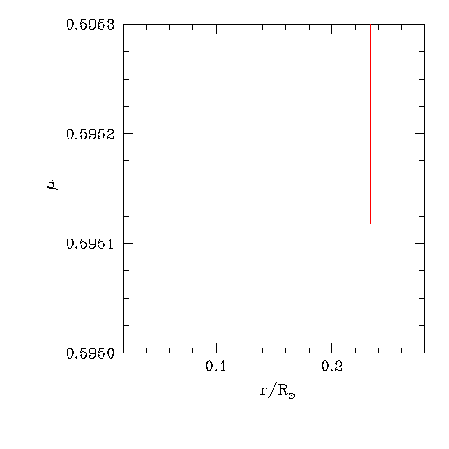
Thermohaline convection as a mechanism for extra mixing in RGB stars
The RGB thermohaline convection is driven by a small difference in µ between a fluid parcel and its surrounding medium because the atomic diffusivity ν is much lower than the heat diffusivity K. It develops when µ decreases with depth (usually, µ increases with depth in stars)

Slide 20
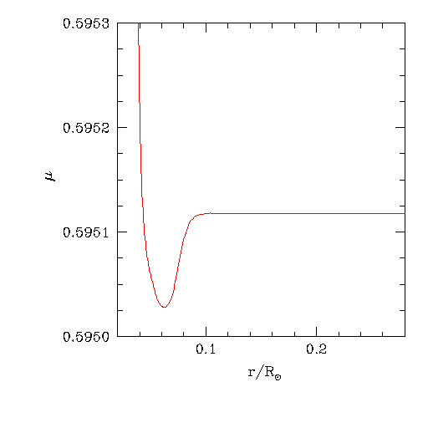
Thermohaline convection as a mechanism for extra mixing in RGB stars
The RGB thermohaline convection is driven by a small difference in µ between a fluid parcel and its surrounding medium because the atomic diffusivity  is much lower than the heat diffusivity K. It develops when µ decreases with depth (usually, µ increases with depth in stars)
Reaction ³He(³He,2p)⁴He decreases µ locally by |Δµ | ‹ 0.0001 (Eggleton et al. 2006)

Slide 21
Gratton et al. (2000) observations can be reproduced with the linear-theory approximation for the RGB thermohaline mixing only if a>7 (blue curves). Aspect ratios can be estimated accurately enough only with direct numerical simulations that solve the Boussinesq equations

Slide 22
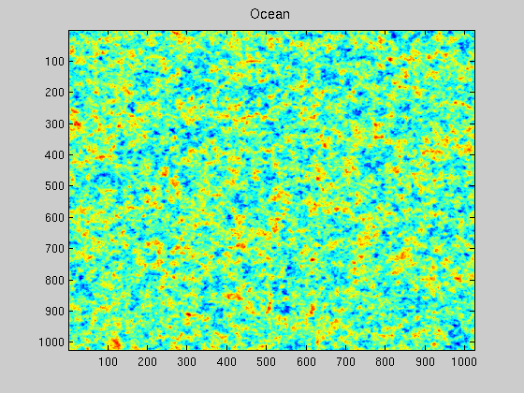

2D numerical simulations of thermohaline convection in the oceanic and RGB cases (a change of color from red to blue corresponds to an increase of S and µ)
Salinity field
Mean molecular weight field

Slide 23
2D results: diffusion coefficient (red) is too small but it increases with viscosity, provided that horizontal mixing remains slow

Slide 24
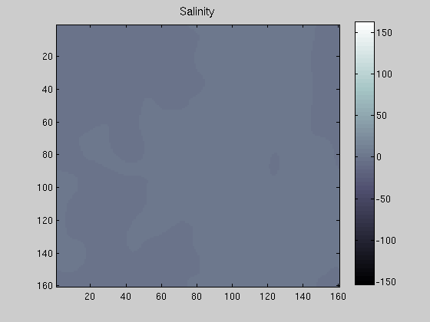
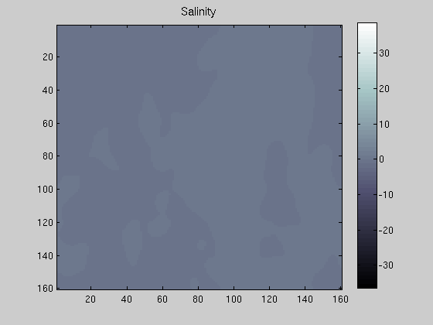
3D numerical simulations of the oceanic and RGB thermohaline convection
Ocean (S)
RGB (µ)

Slide 26
Peclet number is the ratio of ν/K, where the turbulent diffusivity (viscosity) ν may come from different sources. In particular, it may originate from shear (K-H) instability caused by differential rotation of the radiative zone
So, rotation-induced shear mixing may enhance the viscosity by a factor of 100

Slide 27
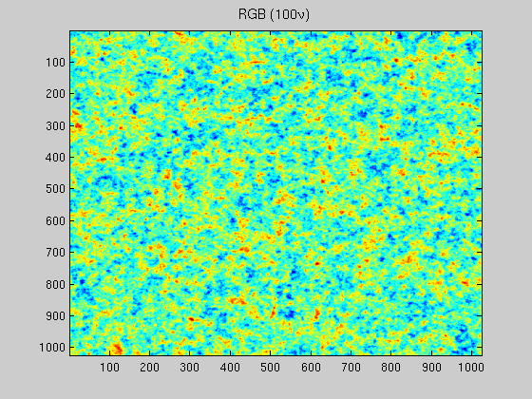

Enhanced (turbulent) viscosity facilitates the growth of salt-fingers by reducing the destructive effect of large-scale instabilities

Slide 28
The End

Slide 29
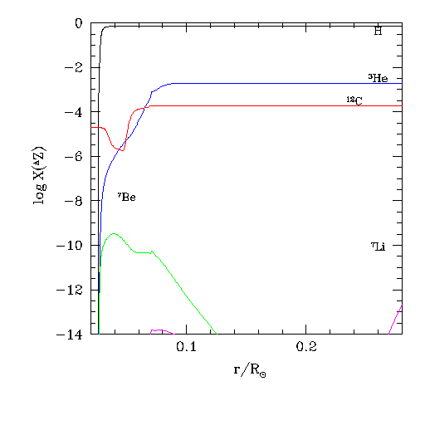
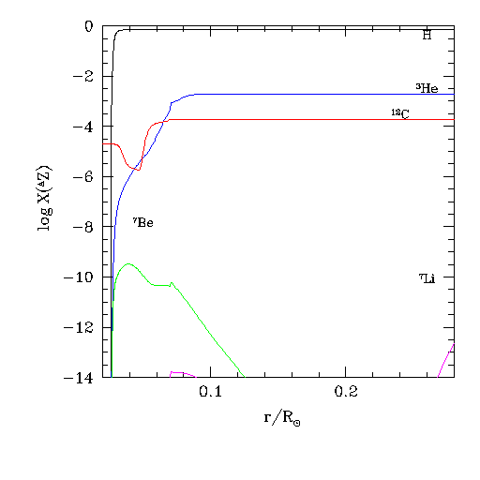
Left: Canonical extra mixing with D_{mix} = 4 × 10⁸ cm² s⁻¹ Right: Enhanced extra mixing with D_{mix} = 4 × 10¹⁰ cm² s⁻¹
Enhanced EM in rapidly rotating Li-rich K giants
³He(⁴He,γ)⁷Be(e,ν)⁷Li - Cameron-Fowler mechanism

Slide 30
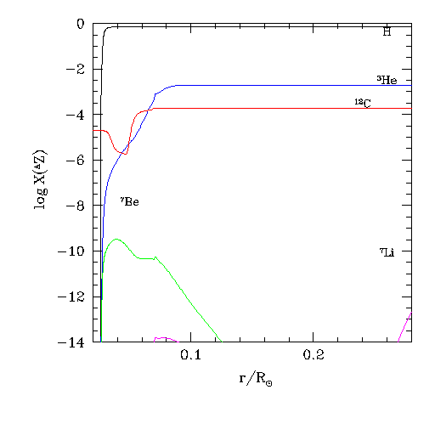
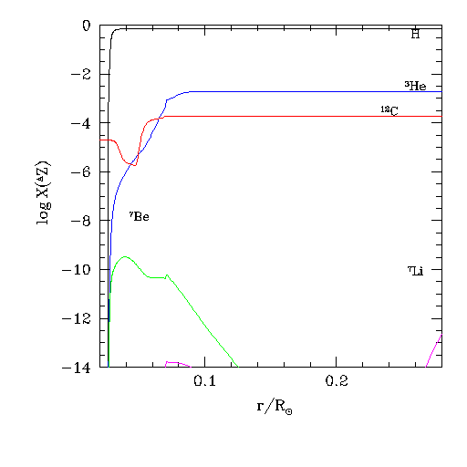
Left: Canonical extra mixing with D_{mix} = 4 × 10⁸ cm² s⁻¹ Right: Enhanced extra mixing with D_{mix} = 4 × 10¹⁰ cm² s⁻¹
Enhanced EM in rapidly rotating Li-rich K giants
³He(⁴He,γ)⁷Be(e,ν)⁷Li - Cameron-Fowler mechanism

Slide 31
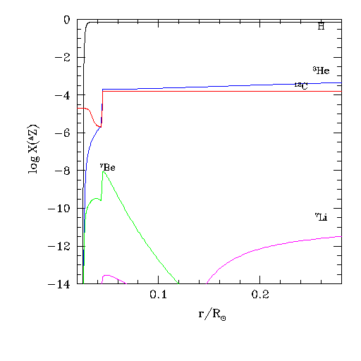
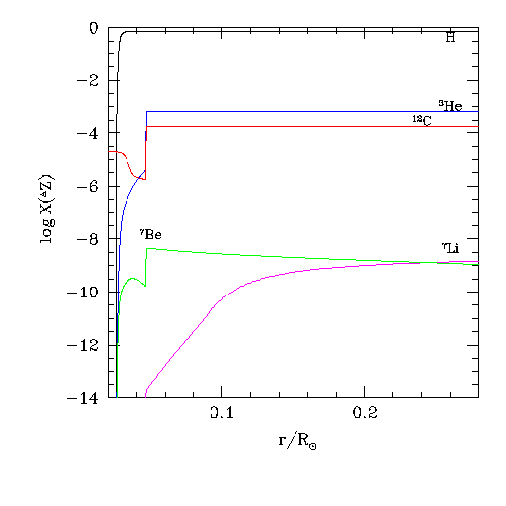
Left: Canonical extra mixing with D_{mix} = 4 × 10⁸ cm² s⁻¹ Right: Enhanced extra mixing with D_{mix} = 4 × 10¹⁰ cm² s⁻¹
Enhanced EM in rapidly rotating Li-rich K giants
³He(⁴He,γ)⁷Be(e,ν)⁷Li - Cameron-Fowler mechanism

